Slide 1
SMART PUBLIC RESTROOM USING IOT(phase-ii)
NAME : LOKESH D
REG.NO : 212921106044
DEPT : ECE
YEAR : III
COLLEGE: ST.JOSEPH COLLEGE OF ENGINEERING-2129
DOMAIN : INTERNET OF THINGS
SUBMITTED BY
LOKESH.D

Slide 2
ABSTRACT
In the cutting edge world, the advances are definitely grown, yet at the same time the cleanliness in our nation is under risk. The abstract of this paper is to deliver clean and hygiene toilets. All the public toilets should be clean and hygiene. In our country, our government has introduced the scheme called “Swachh Bharat” (Clean India). Keeping the toilets uncontaminated is the one of the objective of Clean India scheme. This paper can be helpful to encourage the clean India project. In future, it can show the major part in clean India scheme. In an Existing system, they are focused only on identifying the dirt in the toilets.

Slide 3
KEY WORDS
Smell Sensor
IR Sensor
Sonic Sensor
RFID Reader
IOT

Slide 4
ABSTRACT [cont’s]
In our proposed system, we have determined on keeping clean toilets, observing the sweeper’s working activities. It can dodge many syndromes. It may create the consciousness amongst people about the toilet management. Therefore, our development is to use safe and hygienic toilets. This paper is based on IOT and image-processing concepts using different sensors like smell sensor, IR sensor, sonic sensor, RFID reader. By using these sensors, we can create the smart toilets.

Slide 5
introduction
In our country, people do not have enough knowledge of using toilets. This leads to several diseases, such as Malaria, Hepatitis, Flu, Cholera, Streptococcus, Typhoid, etc. Hence we introduce the concept in the IOT called "Swachh Shithouse" The term Swachh means ‘Clean’. Then the term Shithouse means ‘Toilet’.

Slide 6
INTRO [Cont’s]
It is introduce to use and maintain the toilets in the clean and hygienic way. The project is based on IOT concepts using different sensors like smell sensor, dirt sensor, sonic sensor, RFID reader, Database. Using these materials we are trying to provide the clean toilets and create the awareness among the people.

Slide 7
Scope of the project
In this paper we are going to provide the clean toilet. This paper can create the awareness among the people about the clean and hygienic toilets. This paper can ensure the responsibilities of the sweeper. Finally, this concept is the one of the stepping stone to the “Clean and disease free India”.

Slide 8
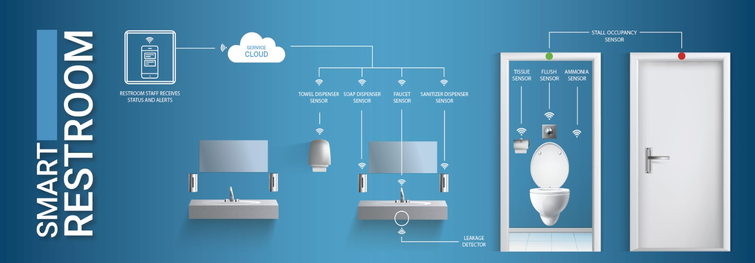
DESIGN PRINCIPLE

Slide 9
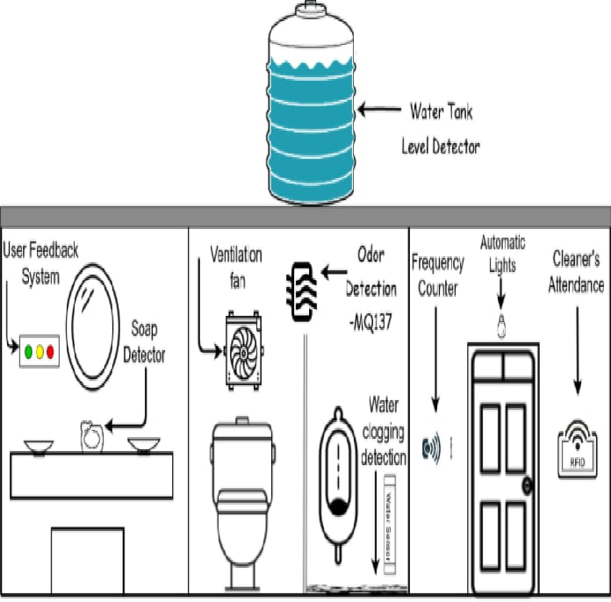
BLOCK DIAGRAM

Slide 10
THANK YOU

